Slide 1

SALES DATA REPORT
PRESENTATION!
BY DESTINY KEVIN 2025
Notes:
To use this title animation slide with a new image simply 1) move the top semi-transparent shape to the side, 2) delete placeholder image, 3) click on the picture icon to add a new picture, 4) Move semi-transparent shape back to original position, 5) Update text on slide.

Slide 2
INTRODUCTION
This project has a dashboard that was designed to transform raw logistics and sales data into a clear, interactive view of business performance. It highlights key metrics such as sales count, total revenue, average sales, and regional performance etc., giving decision-makers the tools to quickly identify trends, bottlenecks, and opportunities for growth. By leveraging Power BI, the dashboard bridges the gap between data and decision, ensuring that strategic choices are guided by real-time evidence rather than assumptions.
FedEx is a logistics company that curate in courier services. It helps in shipping of customers goods from place to another in the USA.

Slide 3
PROJECT OBJECTIVE
THE AIM of this project is to understand the key performance of Fedex with the following objectives
Objective 1
To collect the company data and understand their sales pattern by using time series and generate the KPI’s
Objective 2
To use statistical charts so as to visualize my findings and communicate it to the company CEO
Objective 3
To provide valid recommendation to stakeholders

Slide 4
KAGGLE- A platform for data science
DATA SOURCE & TOOLS
!
The data set used in this project was gotten from Kaggle website. The data was messy and I had to use my data analysis process to arrange the data in order not to skew my analysis.
TOOLS used for this project is POWER BI and power point.

Slide 5

METHODOLOGY
1
2
3
4
Data Collection
The collection process is from Kaggle.com
Data cleaning
The messy data was cleaned by removing duplicates and error from the date column
Data preparation
The data was prepared and manipulated using DAX
Data visualizing
The project was visualized using various statistical chart provide by power bi desktop
Reference : The basics you can find anywhere 5 Steps To Successful Storytelling Published on April 5, 2014 Featured in: Marketing & Advertising

Slide 6
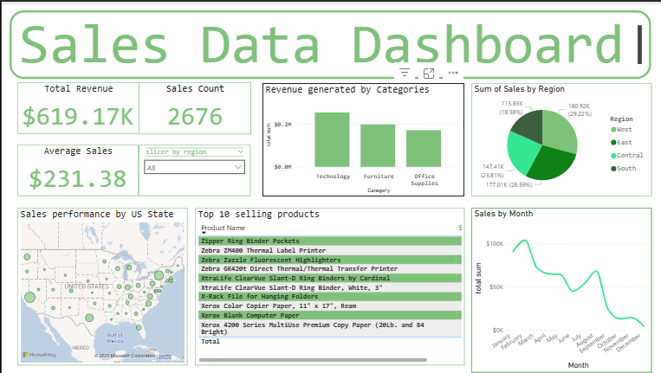
Project visual

Slide 7
EXPLORATORY DATA ANALYSIS
The EDA talks on various data insights gotten from the project
The company total revenue generated was $619.17K with a sales count of 2676 and an average daily sales of $231.8K
The most revenue generated by product category is technology follow by furniture and lastly office supplies
In the revenue generated by months, the sales was at a high peak in January having a price at $90k and a low peak in December having a price at $4k
the four Cardinal point in the USA generated a certain portion by revenue. The west with the highest portion of 29.2%, east- 28.5%, central- 23.8% and the least which is south-18.3%
The most order product from the company is zebra m400 printer sold at $4.6k and the product with least order is the gun flapped white envelope order at $6.6

Slide 8
RECOMMENDATION
The company offers service to all regions in the USA but the south generates the least revenue. the shipping company should try making awareness in the south region so as to boost their brand.
In the Categories technology products has the highest order and office supplies. More resources should be invested in technology products or if likely the company should partner with any technology company for customers to order for gadgets fast and be shipped.
In the time series visual. From January the company generated the highest revenue but as the year run down the figure drops. So more collaboration with company should be considered and PR should be done.

Slide 9
The goal is to turn data into information and information into insights
—CARLY FIORINA

Slide 10
DATA POWERFUL PRESENTATIONS!
THANK YOU
Neal Creative | click & Learn more

